Slide 1
Evaluating Classifiers
DSCI 5240 Data Mining and Machine Learning for Business
Russell R. Torres
Notes:
Module 11: Evaluating Classifiers
Module Objectives:
Identify approaches for estimating error in models
Interpret the confusion matrix and associated metrics
Choose the appropriate evaluation metric(s) for a given business problem
Construct and interpret model assessment charts

Slide 2
Evaluating our Models
True genius resides in the capacity for evaluation of uncertain, hazardous, and conflicting information.
Winston Churchill
Notes:
One of the most important activities a modeler undertakes is determining when to stop. You will notice that the two predominant methodologies for data mining are both cyclical. At what point do we determine that we have a sufficient answer to the underlying business problem. This is the realm of model evaluation and determining which model is best is sometimes more complicated than it might appear.

Slide 3
Gathering Data for Model Evaluation
Given the tools available, creating multiple models of a given phenomenon is generally easy to accomplish
In order to maximize the utility of our data mining efforts, we must choose the “best” model
There are multiple methods commonly used to gather data for the evaluation of classification models
Hold out
Cross validation
Bootstrapping
Notes:
By this point in the course, you may have determined that creating models is easy. That is generally true given that you have invested the necessary time in data preparation. As such, we commonly build many competing models for a given business problem. These might be variations of a given algorithm (linear regressions with 3, 7, and 10 input variables each), or they might be entirely different algorithms (logistic regression vs decision tree vs neural network. This means that we need to consider how to identify which of these models is best. Before getting into how exactly we make that determination, we must first consider how the performance data we use for model evaluation is collected. We will consider the holdout method, cross validation, and bootstrapping.

Slide 4
Holdout
Separate data into training, validation, and test datasets
The training data set is used to construct the classification model
The validation data set is used to fine tune the models, assess their performance, and select the “best” model for a given phenomenon
The test data set is used to estimate the accuracy/future performance of the selected model
It is assumed that each data set is representative of the underlying phenomenon
Generally
More training data → better classifier (to a point)
More validation/testing data → more accurate error estimate
Notes:
You have seen the holdout method before, though we have not used that name. In the holdout method, some portion of the data is used for training and another portion is held out to determine the performance of the model. This is often done using three datasets. The training dataset is used to train the model… that is, provide historical examples of how the attributes of an object (independent variables) are related to a given outcome (dependent variable). The validation set is often used to select the best model from a group of competing models. The test dataset is then used to estimate the error that can be expected when that chosen model is exposed to new data. Each observation from the sample is generally randomly placed into one of these three datasets. This randomization helps to ensure that each dataset has the same general proportion of outcome types as the overall population from which the dataset was drawn. There are occasions, when it is appropriate to conduct a purposive sample in which observations are not chosen randomly. We will see an example of that shortly.
I am often asked what percentage of the data should be allocated to each of these datasets. There is no definitive answer to this question. Generally the more observations contained in your training dataset, the better your model performance against training data. The more data contained in the validation/testing datasets, the better able you are to predict what error rate your model will have when presented with new data.

Slide 5
Holdout
1 | 2 | 3 | 4 | 5 | 6 | 7 | 8 | 9 | 10 | 11 | 12 | 13 | 14 | 15 | 16 | 17 | 18 | 19 | 20 | 21 | 22 | 23 | 24 | 25 | 26 | 27 | 28 | 29 | 30 | 31 | 32 | 33 | 34 | 35 | 36 | 37 | 38 | 39 | 40
1 | 2 | 3 | 4 | 5 | 6 | 7 | 8 | 9 | 10 | 11 | 12 | 13 | 14 | 15 | 16 | 17 | 18 | 19 | 20 | 21 | 22 | 23 | 24 | 25 | 26 | 27 | 28 | 29 | 30 | 31 | 32 | 33 | 34 | 35 | 36 | 37 | 38 | 39 | 40
Estimate Error
n = 40
50/50
 | Original Data
 | Training
 | Testing
Notes:
For simplicity, I will only consider training and testing datasets. In this example, each box represents an observation in the dataset (rows). This dataset contains 40 observations, 50% of which are to be allocated to the training data and 50% to be allocated to the testing data. As previously mentioned, this allocation is performed randomly. The model is developed using the training data, and we use the testing data to produce a point estimate of the expected error once deployed.

Slide 6
Holdout Variations
Stratified Holdout
It is possible that a class is rare and may not be represented in the training set
This would prevent a model from being trained to accurately predict such cases
Divide original data into strata by class labels and then sample with each stratus for training and testing sets
i.e., oversample rare event or undersample frequent event
Repeated Holdout (Monte Carlo Cross-Validation)
Repeat the holdout procedure with different randomly selected subsamples
Different test sets may overlap
Error rates are averaged to produce an overall error rate
Notes:
If you find that your target event is exceedingly rare, you may consider a stratified holdout. An unbalanced target event can be problematic as it may mean your classifier doesn’t have a real opportunity to identify the pattern that leads to your desired outcome… its just not there. This becomes worse as you split your original dataset into the training, validation, and testing sets. In fact, it is possible that one of your datasets may not have any instances of the target event. A stratified holdout helps to ensure that the levels of the target variable are roughly evenly represented, which will often make your classifier perform better. There are two approaches to stratification. The first is undersampling, in which we use all of the target event records and some random subset (undersample) of the non-target event records. The second approach, oversampling, either duplicates target event records or synthetically creates fake, but representative target event records.
Another variation of the holdout technique is called the repeated holdout. The primary advantage of this approach is that the estimate of the error we should expect upon deployment of the model should be more accurate.

Slide 7
Undersampling
50%
50%
1
0
Notes:
In the simplest case of undersampling, we use all of the rare target event records. We then randomly select an equal number of non-target event records. This results in a dataset in which the target and non-target events are equally representative. The downside to this approach is that resulting dataset will be much smaller than the original.

Slide 8
Oversampling
50%
50%
1
0
Notes:
In oversampling, we either duplicate or generate representative target event records. We can do this until the target event records are represented in approximately equal numbers to the non-target event.

Slide 9
Rare Events
1 | 2 | 3 | 4 | 5 | 6 | 7 | 8 | 9 | 10 | 11 | 12 | 13 | 14 | 15 | 16 | 17 | 18 | 19 | 20 | 21 | 22 | 23 | 24 | 25 | 26 | 27 | 28 | 29 | 30 | 31 | 32 | 33 | 34 | 35 | 36 | 37 | 38 | 39 | 40
1 | 2 | 3 | 4 | 5 | 6 | 7 | 8 | 9 | 10 | 11 | 12 | 13 | 14 | 15 | 16 | 17 | 18 | 19 | 20 | 21 | 22 | 23 | 24 | 25 | 26 | 27 | 28 | 29 | 30 | 31 | 32 | 33 | 34 | 35 | 36 | 37 | 38 | 39 | 40
This won’t work!
None of the rare events we are trying to predict actually show up in our training data!
n = 40
50/50
 | Original Data – 1
 | Original Data – 0
 | Training
 | Testing
Notes:
Consider this scenario in which our target event is represented in about 10% of our data. Given that we have 40 observations, that means that we have 4 target events total. If we randomly assign observations to the training and testing datasets, it is possible that no target event records will appear in the training data. In that case, it is impossible for the algorithm to learn the appropriate rules.

Slide 10
Stratified Holdout
1 | 2 | 3 | 4 | 5 | 6 | 7 | 8 | 9 | 10 | 11 | 12 | 13 | 14 | 15 | 16 | 17 | 18 | 19 | 20 | 21 | 22 | 23 | 24 | 25 | 26 | 27 | 28 | 29 | 30 | 31 | 32 | 33 | 34 | 35 | 36 | 37 | 38 | 39 | 40
Stratify and randomly undersample the frequent event
3 | 5 | 13 | 15 | 17 | 21 | 33 | 40
3 | 5 | 13 | 15 | 17 | 21 | 33 | 40
Estimate Error
n = 40
50/50
 | Original Data – 1
 | Original Data – 0
 | Training
 | Testing
Notes:
In this example, we undersample the frequent event. We start by retaining all 4 of the target event records. We then randomly select 4 non-target event records. This results in a dataset where both are represented equally. We can then allocate records to our training and testing datasets.

Slide 11
Repeated Holdout
1 | 2 | 3 | 4 | 5 | 6 | 7 | 8 | 9 | 10 | 11 | 12 | 13 | 14 | 15 | 16 | 17 | 18 | 19 | 20 | 21 | 22 | 23 | 24 | 25 | 26 | 27 | 28 | 29 | 30 | 31 | 32 | 33 | 34 | 35 | 36 | 37 | 38 | 39 | 40
1 | 2 | 3 | 4 | 5 | 6 | 7 | 8 | 9 | 10 | 11 | 12 | 13 | 14 | 15 | 16 | 17 | 18 | 19 | 20 | 21 | 22 | 23 | 24 | 25 | 26 | 27 | 28 | 29 | 30 | 31 | 32 | 33 | 34 | 35 | 36 | 37 | 38 | 39 | 40
1 | 2 | 3 | 4 | 5 | 6 | 7 | 8 | 9 | 10 | 11 | 12 | 13 | 14 | 15 | 16 | 17 | 18 | 19 | 20 | 21 | 22 | 23 | 24 | 25 | 26 | 27 | 28 | 29 | 30 | 31 | 32 | 33 | 34 | 35 | 36 | 37 | 38 | 39 | 40
…
1 | 2 | 3 | 4 | 5 | 6 | 7 | 8 | 9 | 10 | 11 | 12 | 13 | 14 | 15 | 16 | 17 | 18 | 19 | 20 | 21 | 22 | 23 | 24 | 25 | 26 | 27 | 28 | 29 | 30 | 31 | 32 | 33 | 34 | 35 | 36 | 37 | 38 | 39 | 40
Estimate Error
1 | 2 | 3 | 4 | 5 | 6 | 7 | 8 | 9 | 10 | 11 | 12 | 13 | 14 | 15 | 16 | 17 | 18 | 19 | 20 | 21 | 22 | 23 | 24 | 25 | 26 | 27 | 28 | 29 | 30 | 31 | 32 | 33 | 34 | 35 | 36 | 37 | 38 | 39 | 40
n = 40
50/50
 | Original Data
 | Training
 | Testing
Notes:
Statisticians hate point estimates! Assume for a moment that we do a standard holdout procedure. We train the model and then estimate some error metric (mean squared error, for example). How accurate do you think that error estimate is? In reality, we should have very little confidence that that point estimate of error is correct. The advantage of the repeated holdout method is that we can get a better, more trustworthy estimate of error. Repeated holdout takes the original observations and divides them randomly between training and validation. We then train the model and produce a point estimate of error. We then repeat that process many times. At the end, we have many point estimates of error. This makes people who like statistics happy, because we can do things like create a mean error value and associated standard deviation. In so doing, we can have much greater confidence that we understand the level of error we should expect with a given model.

Slide 12
Cross Validation
k-Fold Cross Validation
Data is randomly split into k subsets of (approximately) equal size
For each iteration, one subset is used for testing and the rest are used for training
Cross validation uses sampling without replacement, thus test sets will not overlap
10-fold has been shown to be among the best schemes
Error rates of different iterations are averaged to yield overall error rate
Leave-One-Out Cross Validation
A special case of k-fold where k=n, the number of observations in the data set
For each iteration, one observation is used for testing with the rest used for training
Computationally expensive
Notes:
Cross validation is another approach to creating error estimates. In k-fold cross validation, we split the data into k (usually 10) subsets. We use one subset for testing with the remainder allocated for training. We repeat that process k times. Just like with repeated holdout, we are left with multiple point estimates for error which we can then aggregate into a more trustworthy error. There is a special case of k-fold where we set k equal to the total number of observations. The result is that for each iteration, one record is held out for testing and the remainder are used for training.

Slide 13
k-Fold Cross Validation
1 | 2 | 3 | 4 | 5 | 6 | 7 | 8 | 9 | 10 | 11 | 12 | 13 | 14 | 15 | 16 | 17 | 18 | 19 | 20 | 21 | 22 | 23 | 24 | 25 | 26 | 27 | 28 | 29 | 30 | 31 | 32 | 33 | 34 | 35 | 36 | 37 | 38 | 39 | 40
1 | 2 | 3 | 4 | 5 | 6 | 7 | 8 | 9 | 10 | 11 | 12 | 13 | 14 | 15 | 16 | 17 | 18 | 19 | 20 | 21 | 22 | 23 | 24 | 25 | 26 | 27 | 28 | 29 | 30 | 31 | 32 | 33 | 34 | 35 | 36 | 37 | 38 | 39 | 40
1 | 2 | 3 | 4 | 5 | 6 | 7 | 8 | 9 | 10 | 11 | 12 | 13 | 14 | 15 | 16 | 17 | 18 | 19 | 20 | 21 | 22 | 23 | 24 | 25 | 26 | 27 | 28 | 29 | 30 | 31 | 32 | 33 | 34 | 35 | 36 | 37 | 38 | 39 | 40
…
1 | 2 | 3 | 4 | 5 | 6 | 7 | 8 | 9 | 10 | 11 | 12 | 13 | 14 | 15 | 16 | 17 | 18 | 19 | 20 | 21 | 22 | 23 | 24 | 25 | 26 | 27 | 28 | 29 | 30 | 31 | 32 | 33 | 34 | 35 | 36 | 37 | 38 | 39 | 40
Estimate Error
1 | 2 | 3 | 4 | 5 | 6 | 7 | 8 | 9 | 10 | 11 | 12 | 13 | 14 | 15 | 16 | 17 | 18 | 19 | 20 | 21 | 22 | 23 | 24 | 25 | 26 | 27 | 28 | 29 | 30 | 31 | 32 | 33 | 34 | 35 | 36 | 37 | 38 | 39 | 40
n = 40
k = 10
4 test observations per iteration
 | Original Data
 | Training
 | Testing
Notes:
You can see here that k-fold cross validation works in a similar fashion to repeated holdout. Both are iterative, but k-fold is not random in nature, whereas repeated holdout is.

Slide 14
Leave One Out Cross Validation
1 | 2 | 3 | 4 | 5 | 6 | 7 | 8 | 9 | 10 | 11 | 12 | 13 | 14 | 15 | 16 | 17 | 18 | 19 | 20 | 21 | 22 | 23 | 24 | 25 | 26 | 27 | 28 | 29 | 30 | 31 | 32 | 33 | 34 | 35 | 36 | 37 | 38 | 39 | 40
1 | 2 | 3 | 4 | 5 | 6 | 7 | 8 | 9 | 10 | 11 | 12 | 13 | 14 | 15 | 16 | 17 | 18 | 19 | 20 | 21 | 22 | 23 | 24 | 25 | 26 | 27 | 28 | 29 | 30 | 31 | 32 | 33 | 34 | 35 | 36 | 37 | 38 | 39 | 40
1 | 2 | 3 | 4 | 5 | 6 | 7 | 8 | 9 | 10 | 11 | 12 | 13 | 14 | 15 | 16 | 17 | 18 | 19 | 20 | 21 | 22 | 23 | 24 | 25 | 26 | 27 | 28 | 29 | 30 | 31 | 32 | 33 | 34 | 35 | 36 | 37 | 38 | 39 | 40
…
1 | 2 | 3 | 4 | 5 | 6 | 7 | 8 | 9 | 10 | 11 | 12 | 13 | 14 | 15 | 16 | 17 | 18 | 19 | 20 | 21 | 22 | 23 | 24 | 25 | 26 | 27 | 28 | 29 | 30 | 31 | 32 | 33 | 34 | 35 | 36 | 37 | 38 | 39 | 40
Estimate Error
1 | 2 | 3 | 4 | 5 | 6 | 7 | 8 | 9 | 10 | 11 | 12 | 13 | 14 | 15 | 16 | 17 | 18 | 19 | 20 | 21 | 22 | 23 | 24 | 25 | 26 | 27 | 28 | 29 | 30 | 31 | 32 | 33 | 34 | 35 | 36 | 37 | 38 | 39 | 40
n = 40
k = 40
1 test observation per iteration
 | Original Data
 | Training
 | Testing
Notes:
Leave one out cross validation works in a similar fashion. However, it will typically result in many more iterations.

Slide 15
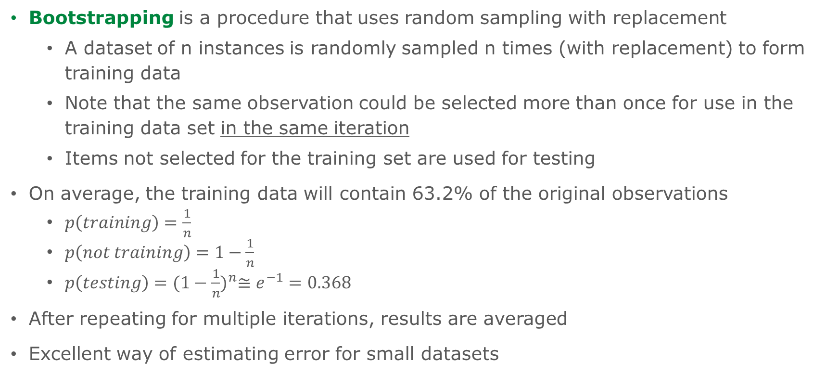
Bootstrapping
Bootstrapping is a procedure that uses random sampling with replacement
A dataset of n instances is randomly sampled n times (with replacement) to form training data
Note that the same observation could be selected more than once for use in the training data set in the same iteration
Items not selected for the training set are used for testing
On average, the training data will contain 63.2% of the original observations
$p\left(training\right)=\frac{1}{n}$
$p\left(not training\right)=1−\frac{1}{n}$
$p\left(testing\right)={(1−\frac{1}{n})}^{n}≅e^{−1}=0.368$
After repeating for multiple iterations, results are averaged
Excellent way of estimating error for small datasets
Notes:
Bootstrapping is yet another iterative approach that allows for improved error estimates. The primary difference between bootstrapping and repeated holdout is that bootstrapping uses sampling with replacement. Recall that in a given iteration in repeated holdout, an observation can only be used once (either for training or for validation). That is because when we randomly sample an observation, it is assigned to the training or testing set and is then removed from further consideration (sampling without replacement). In bootstrapping, a given observation can be randomly chosen to participate in the training dataset multiple times. For a dataset of size n, the bootstrapping procedure randomly samples the data n times (with replacement) to form the training data. Some observations will be selected more than once. Any observations not chosen for training are used for testing. Bootstrapping is sometimes called 63.2% bootstrapping because, on average, the training data will contain 63.2% of the original observations. Bootstrapping is particularly good for estimating error in small datasets.

Slide 16
(0.632) Bootstrapping
1 | 2 | 3 | 4 | 5 | 6 | 7 | 8 | 9 | 10 | 11 | 12 | 13 | 14 | 15 | 16 | 17 | 18 | 19 | 20 | 21 | 22 | 23 | 24 | 25 | 26 | 27 | 28 | 29 | 30 | 31 | 32 | 33 | 34 | 35 | 36 | 37 | 38 | 39 | 40
60.0%
1 | 2 | 5 | 5 | 5 | 6 | 6 | 8 | 9 | 10 | 13 | 15 | 16 | 17 | 17 | 17 | 18 | 18 | 18 | 20 | 21 | 21 | 21 | 23 | 24 | 25 | 27 | 27 | 28 | 28 | 29 | 29 | 30 | 31 | 32 | 33 | 34 | 34 | 35 | 40
…
3 | 4 | 7 | 11 | 12 | 14 | 19 | 22 | 26 | 36 | 37 | 38 | 39
67.5%
1 | 4 | 4 | 5 | 5 | 6 | 6 | 8 | 11 | 13 | 16 | 16 | 17 | 17 | 19 | 20 | 20 | 20 | 20 | 20 | 22 | 22 | 23 | 23 | 24 | 24 | 25 | 26 | 27 | 29 | 30 | 32 | 32 | 33 | 33 | 34 | 35 | 35 | 40 | 40
Estimate Error
2 | 3 | 7 | 9 | 10 | 12 | 14 | 15 | 18 | 21 | 28 | 31 | 36 | 37 | 38 | 39
 | Original Data
 | Training
 | Testing
n = 40
Notes:
Notice in the first iteration, some observations were selected multiple times for the training data (5, 6, etc.). Any observation not selected for training is used for testing. As with all of our iterative methods, we estimate error multiple times and aggregate to get a better estimate.

Slide 17
Model Evaluation
Once we have (one way or another) divided our dataset into training and testing sets, we must evaluate performance of the model for the test set
Many methods exist for comparing models
Confusion matrix
Mean Squared Error (MSE)
Root Mean Squared Error (RMSE)
Model Assessment Charts
% Response Charts
Lift Charts
Gains Charts
ROC Charts
Notes:
The methods shown here for comparing models is not intended to be exhaustive. There are many additional metrics. These approaches should give you a general feel for how model comparison is conducted.

Slide 18
Some Thoughts on Model Accuracy…
Assume the typical response rate from a mailing campaign is 1%
A highly paid data analyst has produced two models:
Model A accurately classifies 90% of all observations in the validation set
Model B accurately classifies 99% of all observations in the validation set
Which model would you choose?

Slide 19
Some Thoughts on Model Accuracy…
What if I told you that Model B is a naïve model that predicts that no customer will ever respond?
Classification accuracy is 99% because only about 1% of customers respond
The model ends up being very accurate but entirely useless!
You need to know the source of error, not just the error rate.
Notes:
People often focus on model accuracy. It is always important to consider accuracy, but it is important to recognize that accuracy is not everything. As demonstrated by the scenario above, it is possible to have a model with extremely high accuracy that is completely unusable. The takeaway is that we need to understand the nature of the error that exists in a model, not just whether or not it is present.

Slide 20
So What is a Confusion Matrix?
 |  | Predicted
 |  | Positive | Negative
Actual | Positive | a | b
 | Negative | c | d
a: number of positive instances predicted as positive (true positive)
b: number of positive instances predicted as negative (false negative)
c: number of negative instances predicted as positive (false positive)
d: number of negative instances predicted as negative (true negative)
Notes:
One of the ways we understand the error present in a model is through the use of the confusion matrix. The confusion matrix counts and organizes the number of observations that are correctly predicted as positive (true positives), correctly predicted as negative (true negatives), incorrectly predicted as positive (false positive), and incorrectly predicted as negative (false negative). If we have a binary dependent variable (0 or 1), a record is a true positive if the actual value was 1 and we predicted 1. It is a true negative if the actual value was a 0 and we predicted 0. It is a false positive if the actual value was 0 and we predicted 1. It is a false negative if the actual value was 1 and we predicted 0. You may be familiar with Type I and Type II errors from a previous statistics class. A false positive is a Type I error and a false negative is a Type II error.

Slide 21
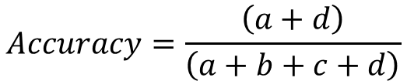
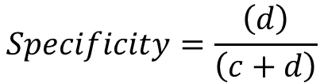
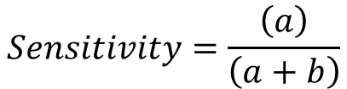
Confusion Matrix Terms
 |  | Predicted
 |  | + | -
Actual | + | a | b
 | - | c | d
Accuracy: Proportion of correct predictions
$$Accuracy=\frac{\left(a+d\right)}{\left(a+b+c+d\right)}$$
Sensitivity (True Positive Rate): Proportion of positive cases correctly classified as positive
$$Sensitivity=\frac{\left(a\right)}{\left(a+b\right)}$$
Specificity (True Negative Rate): Proportion of negative cases correctly classified as negative
$$Specificity=\frac{\left(d\right)}{\left(c+d\right)}$$
Notes:
From the values in the confusion matrix we can calculate a wide variety of statistics that can be used to compare model performance. Accuracy is simply the number of times the model was correct (true positive and true negative) divided by all observations. Sensitivity, the true positive rate (also called recall), is the ratio of true positives to all positive observations. Sensitivity tells you how well your model identifies true positive values. It answers the question, “when the value is actually 1, how often does the model predict 1?” Specificity, the true negative rate, is the analogous metric for negative observations. It answers the question “when the value is 0, how often does the model predict 0?”

Slide 22
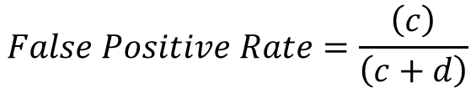
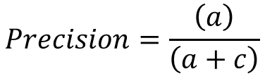
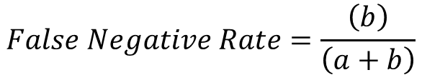
Confusion Matrix Terms
 |  | Predicted
 |  | + | -
Actual | + | a | b
 | - | c | d
False Positive Rate: Proportion of negative cases incorrectly
classified as positive
$$False Positive Rate=\frac{\left(c\right)}{\left(c+d\right)}$$
False Negative Rate: Proportion of positive cases incorrectly classified as negative
$$False Negative Rate=\frac{\left(b\right)}{\left(a+b\right)}$$
Precision: Proportion of predicted positive cases that were correctly classified
$$Precision=\frac{\left(a\right)}{\left(a+c\right)}$$
Notes:
The false positive rate is the ratio of the number of observations we predicted positive that were actually negative to all negative observations. This tells us when the value is 0, how often do we predict 1. False negative is the analogous metric for positive observations. It answers the question, “when the value is 1, how often does the model predict 0?” Precision is the proportion of correctly classified positive cases to all predicted positives. It answers the question, “when we predict 1, how often are we correct?”
For more details about the confusion matrix, see https://www.youtube.com/watch?v=8Oog7TXHvFY.

Slide 23
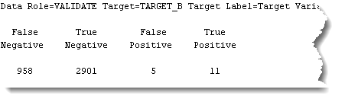
Confusion Matrix in Real Life
 |  | Predicted
 |  | Positive | Negative
Actual | Positive | 11 | 958
 | Negative | 5 | 2901
Notes:
On the bottom left of this slide you see a portion of the output from SAS Enterprise Miner. This particular table, is part of the output of a logistic regression model. Notice that, while they don’t conform to the confusion matrix format we discuss here, these values are confusion matrix counts. SAS Enterprise Miner produces this confusion matrix for every classification model, which allows you to compare models even if they use different algorithms.

Slide 24


















Confusion Matrix Example
 |  | Predicted
 |  | 1 | 0
Actual | 1 | 15 | 10
 | 0 | 5 | 70
 |  | Predicted
 |  | 1 | 0
Actual | 1 | 20 | 20
 | 0 | 0 | 60
$$Accuracy=$$
$$\frac{\left(70+15\right)}{\left(100\right)}=0.85$$
$$Accuracy=\frac{\left(60+20\right)}{\left(100\right)}=0.80$$
$$\frac{\left(15\right)}{\left(15+10\right)}=0.60$$
$$Sensitivity=\frac{\left(20\right)}{\left(20+20\right)}=0.50$$
$$Sensitivity=$$
$$Specificity=$$
$$\frac{\left(70\right)}{\left(5+70\right)}=0.93$$
$$Specificity=\frac{\left(60\right)}{\left(0+60\right)}=1.00$$
$$FPR=$$
$$\frac{\left(5\right)}{\left(5+70\right)}=0.07$$
$$FPR=\frac{\left(0\right)}{\left(0+60\right)}=0.00$$
$$FNR=$$
$$\frac{\left(10\right)}{\left(15+10\right)}=0.40$$
$$FNR=\frac{\left(20\right)}{\left(20+20\right)}=0.50$$
$$\frac{\left(15\right)}{\left(15+5\right)}=0.75$$
$$Precision=\frac{\left(20\right)}{\left(20+0\right)}=1.00$$
$$Precision=$$
Notes:
In this example, you see the confusion matrices associated with two competing models. Which model is better? The right answer is that it cannot be determined from the information we have here. What is the context of the business question? In some cases, for example, you may want to maximize specificity, in others you may want to maximize sensitivity or some other metric. To select the appropriate metric, you have to consider the context and understand the cost (monetary or otherwise) of getting a prediction wrong.

Slide 25

The Cost of Getting it Wrong
 |  | Predicted
 |  | Positive | Negative
Actual | Positive
 | Negative
✓
✗
✗
✓
Notes:
Consider a simple example in which we create a classifier to predict whether or not someone is pregnant. Obviously a medical test would be more appropriate, but this is just an illustrative example. If we predict that the person is pregnant and they are, all is well. The same is true if we predict that they are not pregnant and they are not. However, there are costs associated with getting our prediction wrong. If the model predicts pregnancy but the person is not actually pregnant, there are implications. There may be financial implications… what if the parents rush out and start buying baby furniture? There may be psychological implications… consider the mental state of the parents when they find they are not having a baby. These negative implications are bad, but are relatively short-lived. Now consider the costs associated with predicting no pregnancy when the individual is, indeed, pregnant. What are the costs? While there are numerous issues, the most significant would likely be health related issues for both parent and child, because prenatal health care would probably be significantly delayed. This false negative likely outweighs the costs of a false positive. Thus, we would focus on models which minimize the false negative rate.

Slide 26
Confusion Matrix Example
 |  | Predicted
 |  | Defaulter | Non-defaulter
Actual | Defaulter | 15 | 10
 | Non-defaulter | 5 | 70
 |  | Predicted
 |  | Defaulter | Non-defaulter
Actual | Defaulter | 20 | 20
 | Non-defaulter | 0 | 60
Assume:
It costs our organization $20,000 when we loan to a defaulter
We lose $5,000 in revenue when we refuse a loan to a non-defaulter
But what if:
It costs our organization $4,000 when we loan to a defaulter
We lose $10,000 in revenue when we refuse a loan to a non-defaulter
$$Cost=10×\$20,000+5×\$5,000=\$225,000$$
$$Cost=20×\$20,000+0×\$5,000=\$400,000$$
$$Cost=10×\$4,000+5×\$10,000=\$90,000$$
$$Cost=20×\$4,000+0×\$10,000=\$80,000$$
Notes:
We might also make such a selection based on monetary costs related to the prediction. In this example, we calculate the cost and revenue associated with each type of prediction and attempt to maximize profit. It is very important that the dollar values you attach to each outcome are accurate, as inaccuracies can lead to the selection of non-optimal models.

Slide 27
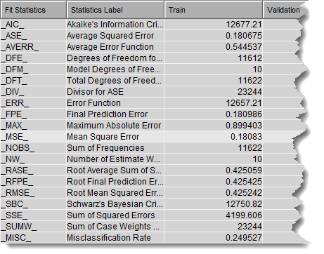
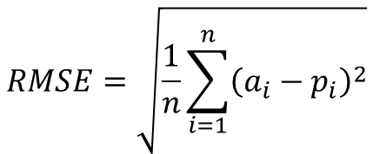
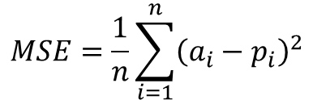
Other Error Metrics
Mean squared error (MSE) measures the mean difference between actual and predicted values
$$MSE=\frac{1}{n}\sum_{i=1}^{n}{{\left(a_{i}−p_{i}\right)}^{2}}$$
The root mean squared error (RMSE) is also often used as it has the same units as the original data
$$RMSE=\sqrt{\frac{1}{n}\sum_{i=1}^{n}{{\left(a_{i}−p_{i}\right)}^{2}}}$$
Applicable for classifiers that produce some continuous score which are converted to class labels using a threshold
Notes:
There are other means of assessing model performance. The table on the left is the output from a logistic regression. As you can see, there are a wide variety of metrics that can be used to assess the quality of a given model. We will not address all of these metrics… instead, we will focus on a commonly used metric (MSE) to give you a sense of how such measures are calculated and used. The mean squared error is simply the difference between the actual value and the predicted value, squared, summed, and divided by the number of total observations. It is a measure of how much error exists in the model and smaller values are preferred. A variant of MSE is root mean squared error (RMSE) which is exactly the same calculation but the square root of the MSE is taken. This is sometimes advantageous as the RMSE is measured in the same units as the dependent variable. So if you are predicting sales, RMSE would be measured in dollars.

Slide 28
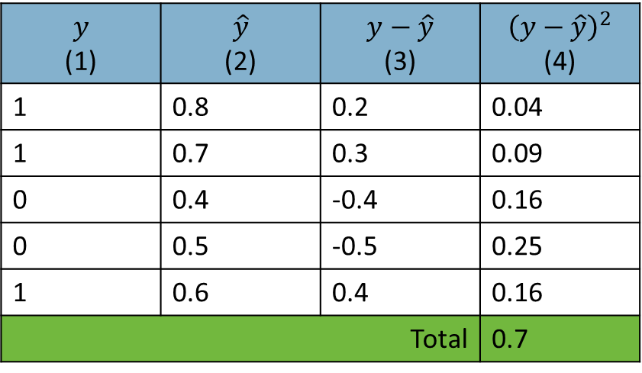
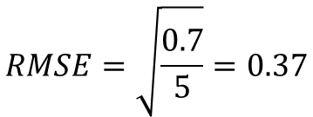
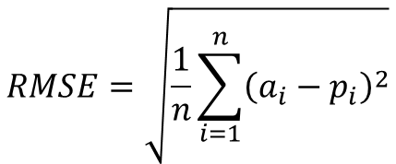

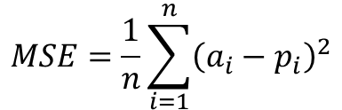
Mean Squared Error Example
$$MSE=\frac{1}{n}\sum_{i=1}^{n}{{\left(a_{i}−p_{i}\right)}^{2}}$$
$$y$$ (1) | $$\hat{y}$$ (2) | $$y−\hat{y}$$ (3) | $${\left(y−\hat{y}\right)}^{2}$$ (4)
1 | 0.8 | 0.2 | 0.04
1 | 0.7 | 0.3 | 0.09
0 | 0.4 | -0.4 | 0.16
0 | 0.5 | -0.5 | 0.25
1 | 0.6 | 0.4 | 0.16
Total |  |  | 0.7
$$MSE=\frac{0.7}{5}=0.14$$
$$RMSE=\sqrt{\frac{1}{n}\sum_{i=1}^{n}{{\left(a_{i}−p_{i}\right)}^{2}}}$$
$$RMSE=\sqrt{\frac{0.7}{5}}=0.37$$
Notes:
In this example we have 5 observations with actual values of y of either 1 or 0 (column 1). In column 2, we have our predicted values of y and in column 3 we have the difference between the two. Column 4 is the square of the differences.

Slide 29
Creating Model Assessment Charts
There are a wide assortment of charts that can also be used to evaluate model performance
Many of these charts share a set of algorithmic steps
Using the model, produce estimated probabilities for the target event for each case
Sort all cases by decreasing estimated probability
Split the cases evenly into n bins so that bin #1 has the highest probabilities and bin #n the lowest probabilities
Now look at the number of cases where the target event actually happens
Calculate statistic of interest for each bin
Notes:
We often evaluate model performance visually using charts. In many cases, these charts are produced automatically by the data mining tool being used.

Slide 30
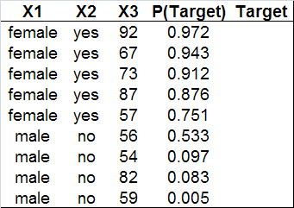
Creating Model Assessment Charts
Event Occurred
Event Did Not Occur
Assume:
n = 180
Count ( ) = 40
Count ( ) = 140
Notes:
Assume our data has the following characteristics. We have three independent variables X1, X2, and X3. We have a probability of the target event occurring (produced by our model), and we have the actual target variable value (denoted here by a blue circle if the event occurred and a white circle if the event did not occur. Assume that we have 180 total responses, 40 in which the event occurred and 140 in which it did not. Our first step in producing model assessment charts would be to sort by the probability column, such that observations with high probabilities are at the top of the table and observations with low probabilities are at the bottom. In general, if our model is good, most of the observations where the target event occurred should be at the top of the table.

Slide 31
Looking Inside the Bins
Good models assign high probabilities to cases which will actually have the target event (defaulting, donating, etc.)
Bin #1
(high probabilities)
Bin #10
(low probabilities)
= target event has ACTUALLY occurred
= target event has actually not occurred
Notes:
This is simply a visual depiction to help you understand what is going on. I have sorted my data by probability and divided it into 10 bins (deciles). Notice that the observations containing the target event are most prevalent in the high probability bins. As we move to the right (to bins with lower probabilities) we see less target observations.

Slide 32

% Response
%Response shows you what percentage of each bin’s contents are target cases (defaulters, donors, etc.)
For example, 83% of cases that ended up in the 1st bin (because they had high probabilities) were observed to actually exhibit the target event
$$\frac{15}{18}=0.83$$
Notes:
Once we have created these sorted bins we can begin to do some calculations for each bin which we will ultimately graph. The first calculation is percent response. This is the ratio of target events to all events for each bin. Here, notice that for bin 1, 15 of 18 observations exhibit the event of interest, so percent response for this bin is 0.83. For bin 2, the percent response is 0.67. We can then create a chart to plot these values.

Slide 33
% Response Charts
Notes:
In general, percent response charts that are high on the left and decline quickly are desirable. This pattern means that your model does a good job of identifying the target event.

Slide 34
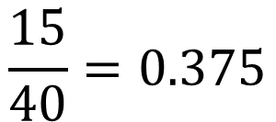
% Captured Response
%Captured Response shows you what percentage of all target cases (defaulters, donors, etc.) are “captured” by each bin
For example, 37.5% of all defaulters may have been captured by the first bin
$$\frac{15}{40}=0.375$$
Notes:
A similar metric is the percent captured response. This is the ratio of target events in a given bin to all target events. In this case, bin 1 contains 15 target events and there are 40 total target events. Thus, bin 1 has a 0.375 percent captured response. Bin 2 has a percent captured response of 0.300.

Slide 35
% Captured Response Chart
Notes:
This type of chart will look exactly like the percent response chart and you should look for the same pattern.

Slide 36
The Baseline Model
What if we assigned cases into the 10 bins randomly? This would create a “baseline” model against which we could measure the performance of our model
Notes:
If we randomly assigned our observations to bins, rather than using the probabilities created by our model, we would expect approximately 4 target observations per bin (40 target observations/10 bins). This represents our baseline, or what would happen if we didn’t use the model to make predictions. We can then compare our model against this baseline to demonstrate how much better our outcomes are if we use the model versus choosing not to use the model.

Slide 37
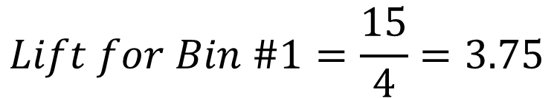
Lift
For each bin, get the ratio of target cases in the model’s bin over target cases in the baseline
Model
Baseline
$$Lift for Bin \#1=\frac{15}{4}=3.75$$
Notes:
The metric we use to compare the performance of our model to the baseline is lift. We calculate lift for each bin by comparing the number of target observations in each bin to the corresponding bin for the baseline model. For bin 1, our model contains 15 target observations and the baseline contains 4, resulting in a lift value of 3.75. You can interpret this number to mean that, for observations in the first bin, they are 3.75 times more likely to contain the target event than if we didn’t use the model.

Slide 38
Lift Charts
Notes:
This plot will also look similar to % response and you can focus on bins with values above 1. Values below 1 indicate that the model is no better than random chance.

Slide 39
Lift Chart Example
Imagine you work for a company that does mass mail promotions to its customers
You have previous data for offers to 200,000 households
Based on this historical data, you know that you can expect a response rate (someone comes to the store to buy something following the promotion) of 0.1% (200 responders)
You develop a model that you believe allows you to identify customers that are likely to respond

Slide 40
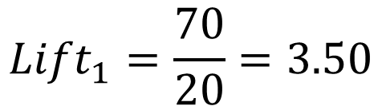
Lift Chart Example
Decile (1) | # of Cases (2) | # Responses (3) | # Responses Expected (4) | Lift (5)
1 | 20,000 | 70 | 20 | 3.50
2 | 20,000 | 40 | 20 | 2.00
3 | 20,000 | 30 | 20 | 1.50
4 | 20,000 | 20 | 20 | 1.00
5 | 20,000 | 15 | 20 | 0.75
6 | 20,000 | 10 | 20 | 0.50
7 | 20,000 | 5 | 20 | 0.25
8 | 20,000 | 5 | 20 | 0.25
9 | 20,000 | 3 | 20 | 0.15
10 | 20,000 | 2 | 20 | 0.10
$${Lift}_{1}=\frac{70}{20}=3.50$$
200 target cases distributed evenly among 10 bins → 20 cases per bin
Notes:
In this table, you see a summary of model performance as well as baseline performance. Column 1 represents the bins. Because you have data for 200,000 customers, each of the 10 bins contains 20,000 observations (column 2). In column 3, I have added the number of target responses per bin as found by your model. Finally in column 4, we have our baseline… we know that 200 customers typically respond (0.1% of 200,000 = 200), divided evenly across 10 bins. We can now calculate lift for each bin. In bin 1, we had 70 target responses based on our model and a baseline of 20 responses, resulting in lift of 3.5.

Slide 41
Lift Chart Example
Notes:
Plotting this example, we see that the model outperforms the baseline through bin 4.

Slide 42
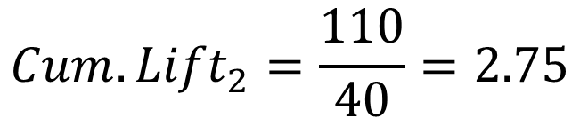
Constructing Cumulative Lift Charts
Decile (1) | Cum. # of Cases (2) | Cum. # Responses (3) | Cum. # Responses Expected (4) | Cum. Lift (5)
1 | 20,000 | 70 | 20 | 3.50
2 | 40,000 | 110 | 40 | 2.75
3 | 60,000 | 140 | 60 | 2.33
4 | 80,000 | 160 | 80 | 2.00
5 | 100,000 | 175 | 100 | 1.75
6 | 120,000 | 185 | 120 | 1.54
7 | 140,000 | 190 | 140 | 1.36
8 | 160,000 | 195 | 160 | 1.22
9 | 180,000 | 198 | 180 | 1.10
10 | 200,000 | 200 | 200 | 1.00
$${Cum. Lift}_{2}=\frac{110}{40}=2.75$$
200 target cases distributed evenly among 10 bins → 20 cases per bin. This is 2 bins worth.
Notes:
A variant of the lift chart can be created using cumulative values. Notice that the numbers for each bin are added to the sum of all prior bins. Cumulative lift is then calculated in the same manner as lift.

Slide 43
Constructing Cumulative Lift Charts

Slide 44
Think About Lift from a Cost Perspective…
Every business action involves costs
In our mailing example, each promotional offer costs us money
Design
Production
Mailing
Lets assume we want to get 100 customers into our store to make a purchase
Without the model, we have to send out 100,000 promotional offers (0.1% of 100,000 is 100)
With the model, we have to send approximately 40,000 promotional offers
That is a HUGE cost savings for this activity

Slide 45
Constructing Gains Charts
Decile | # Cases | Cum. # Cases | # Responses | Cum. # Responses | Cum. # Responses Expected
1 | 20,000 | 20,000 | 70 | 70 | 20
2 | 20,000 | 40,000 | 40 | 110 | 40
3 | 20,000 | 60,000 | 30 | 140 | 60
4 | 20,000 | 80,000 | 20 | 160 | 80
5 | 20,000 | 100,000 | 15 | 175 | 100
6 | 20,000 | 120,000 | 10 | 185 | 120
7 | 20,000 | 140,000 | 5 | 190 | 140
8 | 20,000 | 160,000 | 5 | 195 | 160
9 | 20,000 | 180,000 | 3 | 198 | 180
10 | 20,000 | 200,000 | 2 | 200 | 200
Notes:
If cumulative number of responses is the number of responses our model predicts we can capture for each additional bin of prioritized (by probability) observations, we can compare that to the cumulative number of responses we would expect without the model.

Slide 46
Gains Chart
Savings
Notes:
In this chart, the cumulative baseline value is simply our historical response rate (0.1%) times the number of observations per bin. Notice that the baseline is a straight line. This will generally always be the case. The value of your model is that it allows you to bend that line to your advantage. Notice for the baseline (no model), to get 100 customers into the store to buy something, we must send promotions to 5 deciles worth of people (100,000). If we focus on those our model predicts as most likely to respond, we can achieve the same result by only sending to slightly less than 2 deciles worth of people (40,000). That’s 60,000 pieces of mail we don’t have to send to get the same value, and it represents significant cost savings to the business.

Slide 47
The Importance of Cutoffs in Classification
The notion of cutoffs is integral to classification
A cutoff is a value which determines to which class a given observation should be assigned
For each record
Compute probability of belonging to class “1”
Compare probability to cutoff value and classify accordingly
Assume cutoff is 0.50
If probability >= 0.50 then classify as “1”
If probability < 0.50 then classify as “0”
When evaluating models, the cutoff values of the models in question can have a HUGE impact
Notes:
We have not explicitly discussed cutoffs, but they have always been there. Most of the examples we have discussed are binary classification problems. Notice that we have said our classifiers provide a probability of the target event, some number ranging between 0.0 (the target event will not occur) to 1.0 (the target event will occur). We have implicitly been using 0.5 as our cutoff. If the probability is greater than this value, we correctly presume that the event will be likely to occur. If the probability is less than 0.5, we assume that the event will not occur. However, you should recognize that this cutoff value is entirely arbitrary. What if we wanted to be 80% sure the event would occur before we predicted 1? We can set this cutoff to any value we like… but we need to recognize that the cutoff value we choose affects the predictions made by our model.

Slide 48




Cutoff Example
Obs | Actual Class | Prob. of “1”
1 | 1 | 0.996
2 | 1 | 0.988
3 | 1 | 0.984
4 | 1 | 0.980
5 | 1 | 0.948
6 | 1 | 0.889
7 | 1 | 0.848
8 | 0 | 0.762
9 | 1 | 0.707
10 | 1 | 0.681
11 | 1 | 0.656
12 | 0 | 0.622
Obs | Actual Class | Prob. of “1”
13 | 1 | 0.506
14 | 0 | 0.471
15 | 0 | 0.337
16 | 1 | 0.218
17 | 0 | 0.199
18 | 0 | 0.149
19 | 0 | 0.048
20 | 0 | 0.038
21 | 0 | 0.025
22 | 0 | 0.022
23 | 0 | 0.016
24 | 0 | 0.004
 |  | Predicted
 |  | + | -
Actual | + | 11 | 1
 | - | 2 | 10
$$TPR=\frac{\left(11\right)}{\left(11+1\right)}=0.91$$
$$FPR =\frac{\left(2\right)}{\left(2+10\right)}=0.17$$
 |  | Predicted
 |  | + | -
Actual | + | 7 | 5
 | - | 0 | 12
$$TPR=\frac{\left(7\right)}{\left(7+5\right)}=0.58$$
$$FPR =\frac{\left(0\right)}{\left(0+12\right)}=0.0$$
If cutoff is 0.50, 13 records are classified as “1”
If cutoff is 0.80, 7 records are classified as “1”
Notes:
Changing the threshold of a model changes its performance. In this example we have 24 observations which have been scored by a classifier. Assuming we use a threshold of 0.5, the 13 observations with probabilities larger than 0.5 are classified as 1. This results in a true positive rate of 0.92 and a false positive rate of 0.17. If the cutoff is changed to 0.8, only 7 of the 24 observations are classified as 1 and the true positive rate falls to 0.58 and the false positive rate drops to 0.

Slide 49
The Receiver Operating Characteristics (ROC) Curve
The Receiver Operating Characteristics (ROC) Curve is used in signal detection to characterize the tradeoff between hit rate and false alarm rate
Characterizes the performance of a model using a wide range of cutoff values
Plots performance of classifier in terms of its true positive (vertical axis) and false positive (horizontal axis) rates
True positive rate – the percentage of cases that are positive and are correctly predicted as positive among all the positive cases
False positive rate – the percentage of cases that are negative and are incorrectly predicted as positive among all negative cases
Notes:
The ROC curve has an advantage of being able to represent the performance of a given model against a range of possible cutoff values. This has two important implications. First, the ROC curve might be used to optimize a given model for a particular business situation. For instance, we may be far more interested in ensuring we capture all target events than we are classifying non-target events incorrectly. Second, the ROC curve is an excellent means to compare the performance of multiple competing models and identifying the model with the best possible performance.

Slide 50






ROC Curve Example
Consider a predictive model designed to determine if a given customer will default on a loan
Cutoff 1
If p>0.75, then default
Cutoff 2
If p>0.5, then default
Cutoff 3
If p>0.25, then default
 |  | Predicted
 |  | Yes | No
Actual | Yes | 18 | 14
 | No | 1 | 92
 |  | Predicted
 |  | Yes | No
Actual | Yes | 25 | 7
 | No | 18 | 75
 |  | Predicted
 |  | Yes | No
Actual | Yes | 29 | 3
 | No | 54 | 39
$$TPR=\frac{\left(18\right)}{\left(18+14\right)}=56.25\%$$
$$TPR=\frac{\left(25\right)}{\left(25+7\right)}=78.13\%$$
$$TPR=\frac{\left(29\right)}{\left(29+3\right)}=90.63\%$$
$$FPR=\frac{\left(1\right)}{\left(1+92\right)}=1.08\%$$
$$FPR=\frac{\left(18\right)}{\left(18+75\right)}=19.35\%$$
$$FPR=\frac{\left(54\right)}{\left(54+39\right)}=58.06\%$$
Notes:
To construct a ROC curve, we must first develop a model. In this example, we have a model to predict whether a customer will default on a loan. In the first model, we are fairly conservative and only predict a customer will default if the probability of default is greater than 0.75. As we reduce the threshold, the true positive rate increases because the model captures more and more 1s. However, the false positive rate also increases because we also begin to capture more 0s and predict them as 1s.

Slide 51




ROC Curve Example
What about extreme values for cutoffs?
Cutoff 0
If p>1, then default
Cutoff 4
If p>0, then default
 |  | Predicted
 |  | Yes | No
Actual | Yes | 0 | 32
 | No | 0 | 93
 |  | Predicted
 |  | Yes | No
Actual | Yes | 32 | 0
 | No | 93 | 0
$$TPR=\frac{\left(0\right)}{\left(0+32\right)}=0.00\%$$
$$TPR=\frac{\left(32\right)}{\left(32+0\right)}=100.00\%$$
$$FPR=\frac{\left(0\right)}{\left(0+93\right)}=0.00\%$$
$$FPR=\frac{\left(93\right)}{\left(93+0\right)}=100.00\%$$
Notes:
We also need to examine the extreme values. If we set our cutoff to 1.0, the model will never predict that anyone will default because the probability cannot exceed 1.0. As such, we end up with a true positive rate of 0. We also have a false positive rate of 0 because no 0s in the dataset are predicted as 1s. On the other end of the spectrum, if we set the cutoff to 0, then the model predicts that everyone will default. As such, we capture all of the actual 1s (true positive rate is 1) and we inaccurately predict all 0s as 1s (false positive rate is 0).

Slide 52
ROC Curve Example
Cutoff | True Positive Rate | False Positive Rate
Very High | 0.00% | 0.00%
0.75 | 56.25% | 1.08%
0.5 | 78.25% | 19.35%
0.25 | 90.63% | 58.06%
Very Low | 100.00% | 100.00%
Point of perfect prediction
Predict
all “1”
Predict
all “0”
Notes:
We can then graph the relationship between true positive rate and false positive rate for each of these cutoff values. The resulting graph is the ROC curve for this model. The green line in this graph represents the baseline. A good model will not dip below that line. If you find your model does, your model is actually worse than random guessing. Models are often compared based on a metric called Area Under the Curve (AUC). AUC is represented here as the blue shaded area and is the area under the ROC curve. The larger the AUC, the better the model performs. This is often an excellent metric for use in comparing models.
For more information about the ROC curve, see https://www.youtube.com/watch?v=OAl6eAyP-yo.

Slide 53
Comparing Model Evaluation Techniques
No measure is categorically better than the others
Other relevant factors:
Speed & Scalability
Robustness to noise and missing values
Interpretability
Notes:
There are many ways to assess the performance of a model and compare it against competing models. The approach used should always be driven by the business context and the nature of the decision at hand. In addition to the metric-oriented techniques described in this module, keep in mind that other factors may also be important in the model selection process. Things like speed, scalability, ease of use, ease of interpretation, etc. may all be important when choosing between models.

